Slide 1
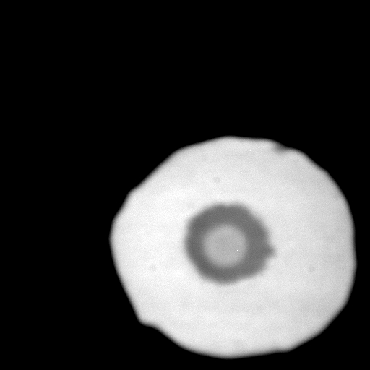
FO76
1 bar
Notes:
1 bar FO76

Slide 2
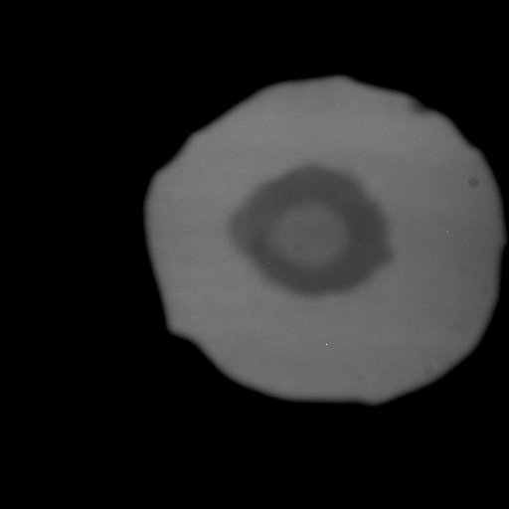
50 GPa
Notes:
50 GPa

Slide 3
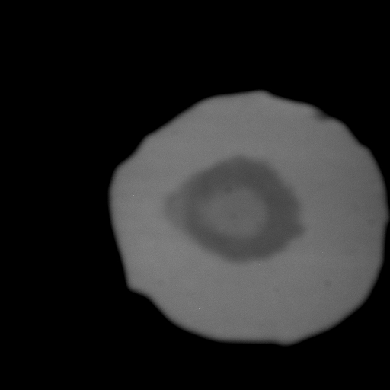
Begin heating, here? At 12 o’clock?
Notes:
1

Slide 4

But mechanical squidge at 9 o’clock
Notes:
2

Slide 5

Notes:
3

Slide 6

Notes:
4

Slide 7

Notes:
5

Slide 8

Notes:
6

Slide 9

Notes:
7

Slide 10

Notes:
8

Slide 11

Notes:
9

Slide 12

Notes:
11

Slide 13

Notes:
12

Slide 14

Notes:
14

Slide 15

Notes:
15

Slide 16

Notes:
16

Slide 17

Notes:
17

Slide 18

Notes:
19

Slide 19
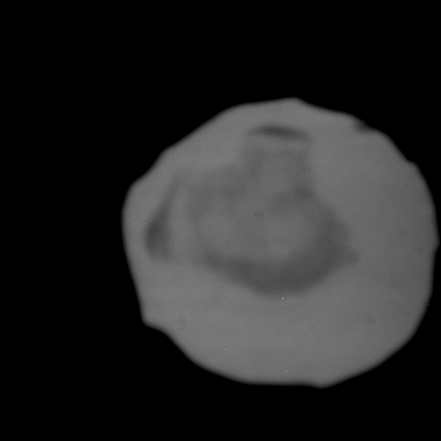
Quenched P = 34 GPa
QUENCHED !Note the difference, and beware quenched samples!
Notes:
20

